Slide 1

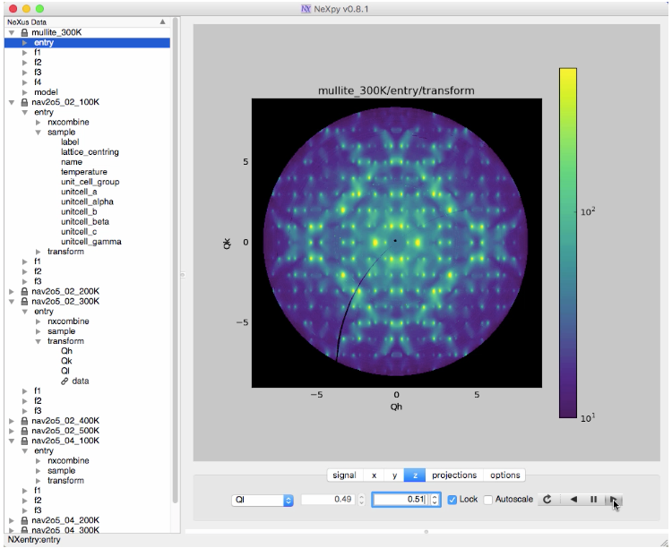

ExFaC Hack-A-Thon
Cloud Access to Big Data
Materials Science Division
Ray Osborn, Stephan Rosenkranz, Matthew Krogstad
Mathematics and Computer Science Division /Computation Institute, Chicago Justin Wozniak, Michael Wilde, Ian Foster Ben Blaiszik, Kyle Chard, Rachana Ananthakrishnan
Advanced Photon Source Guy Jennings

Slide 2
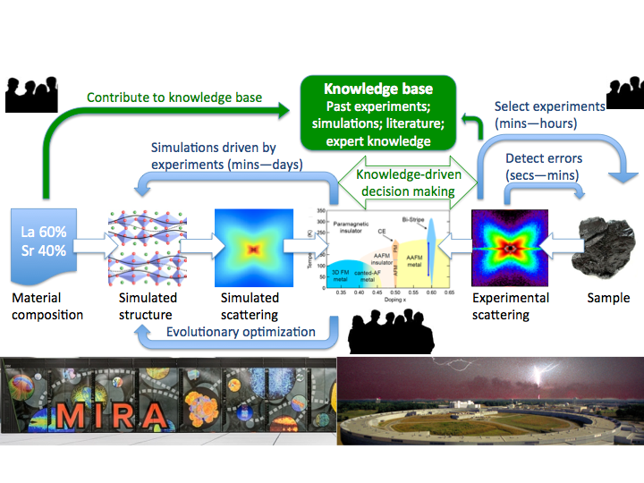
Discovery Engines for Big Data
Integrating Simulation and Observation: Discovery Engines for Big Data
PIs: Ian Foster, Salman Habib, Ray Osborn Coupling experiment and modeling, in cosmology and materials science Develop discovery engine platform for big data applications
ExFaC Hack-a-thon on Cloud Data Servers - Feb. 28 to Mar. 3

Slide 3
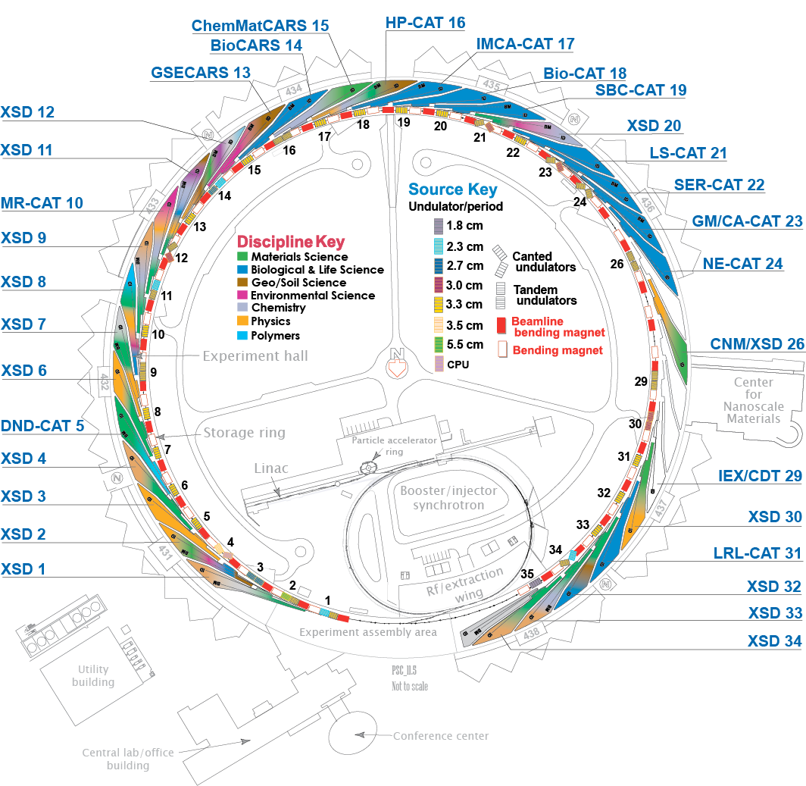
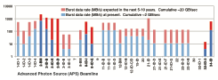
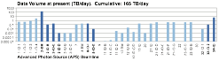
APS Data Rates
ExFaC Hack-a-thon on Cloud Data Servers - Feb. 28 to Mar. 3

Slide 4

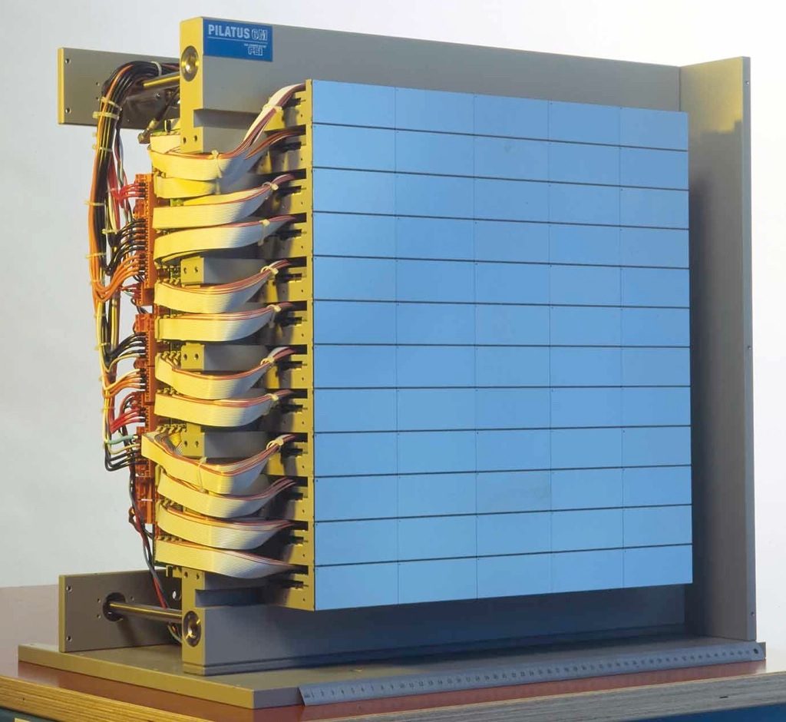

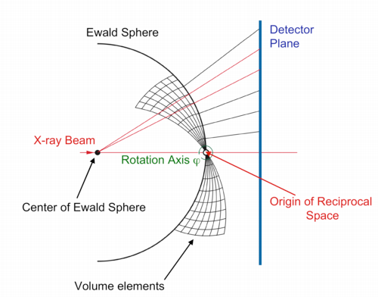
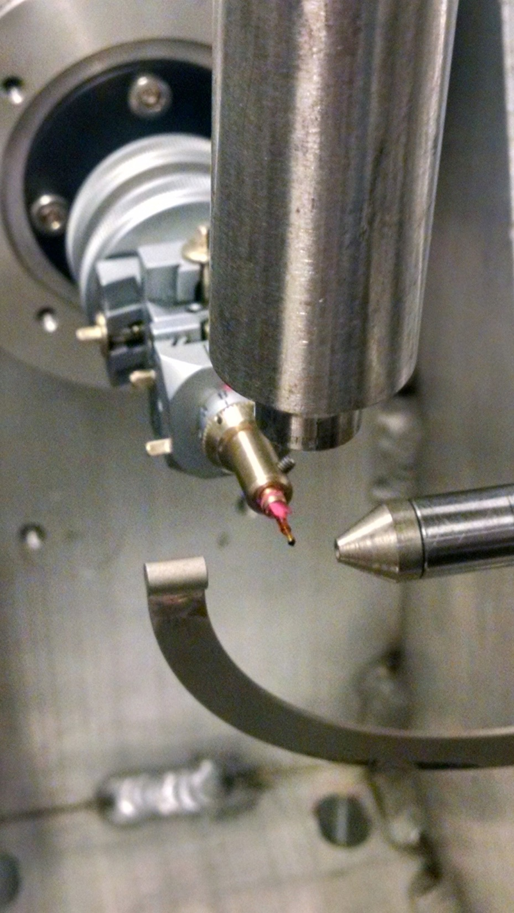
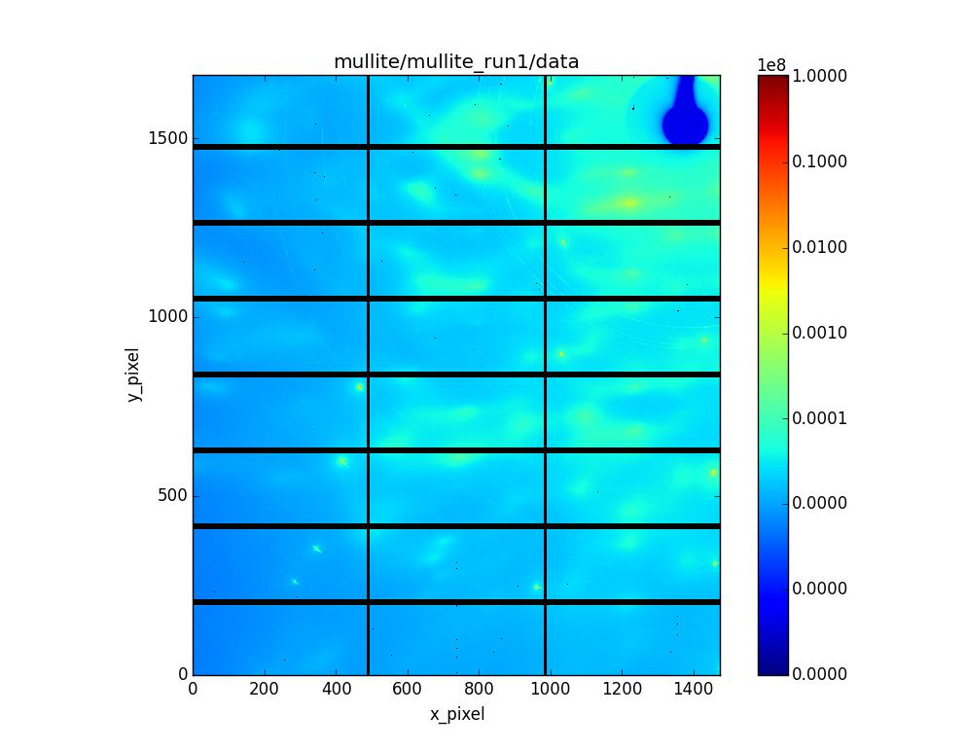
Measuring X-ray Diffuse Scattering with Continuous Rotation Method
Pilatus 2M Detector
The sample is continuously rotated in shutterless mode at 1° per second
A fast area detector (e.g., a Pilatus 2M) acquires images at 10 frames per second
i.e., 3600 x 8MB frames ~ 30GB every 6 minutes - 5TB a day
The detector needs low background, high dynamic range, and energy discrimination
Ideally, this is performed with high-energy x-rays, e.g., 80 to 100 keV
ExFaC Hack-a-thon on Cloud Data Servers - Feb. 28 to Mar. 3

Slide 5
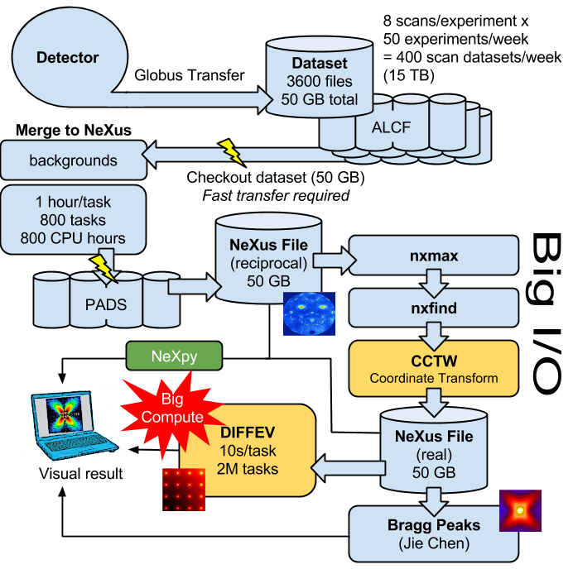
Diffuse Scattering Workflow
Software Development for Synchrotron X-ray Spectroscopies

Slide 6
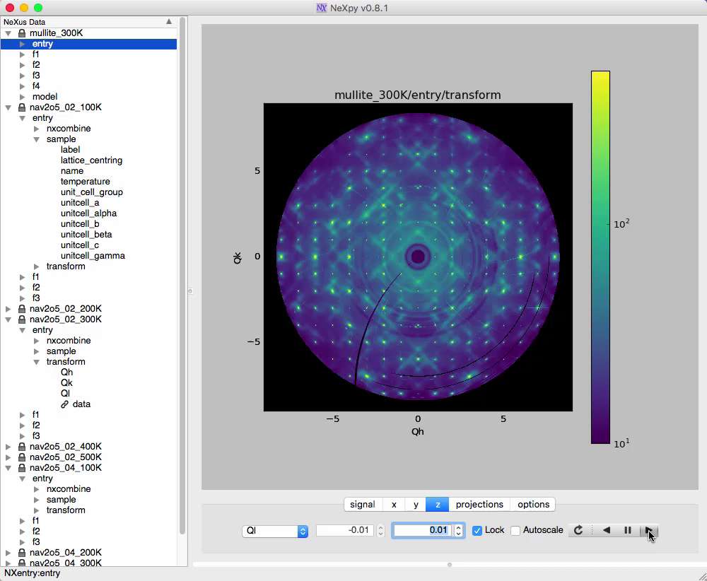
Single Crystal Diffuse Scattering from Mullite
ExFaC Hack-a-thon on Cloud Data Servers - Feb. 28 to Mar. 3
Notes:
Just to give you a flavor of the high quality of this data, here is the three-dimensional diffuse scattering from mullite, an alumina-silicate with highly correlated vacancy distributions. These are (h,k) planes as a function of l and as you can see, the amount of information contained between the Bragg peaks is extremely rich.

Slide 7
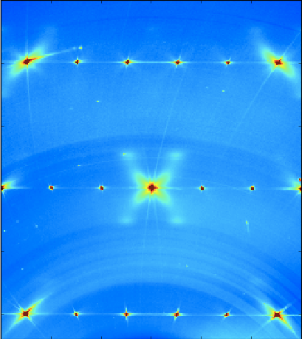
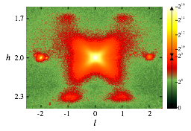
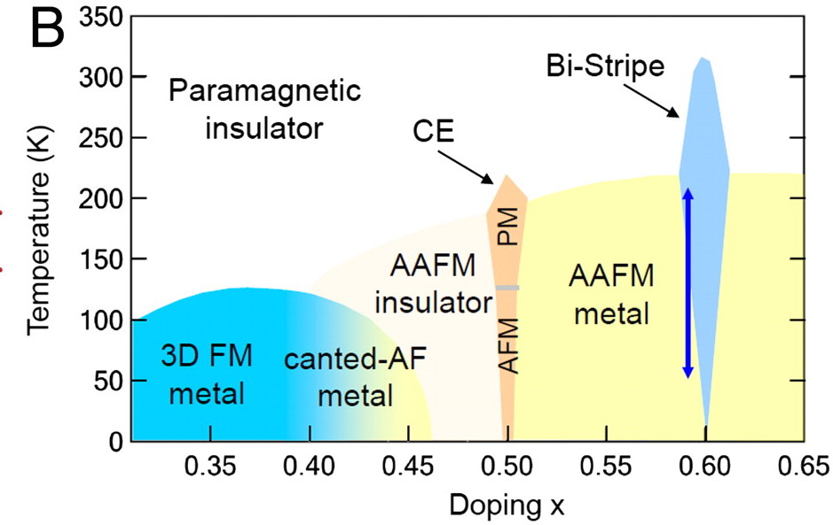
Expanding the Concept of a Data Set
Phase Diagram
Correlated Data Analysis/
Machine Learning
Total Data: S(Q, T, x)
ExFaC Hack-a-thon on Cloud Data Servers - Feb. 28 to Mar. 3
7￼
Notes:
This increase in speed is more than just a qualitative change in how we do science. I think it’s transformative. So while it used to take us a day or so to measure around one Bragg peak, we now collect whole volumes in under half an hour, which allows detailed temperature dependence in half a day, and whole phase diagrams in a week. And every time we do this, we seem to find something unexpected.

Slide 8
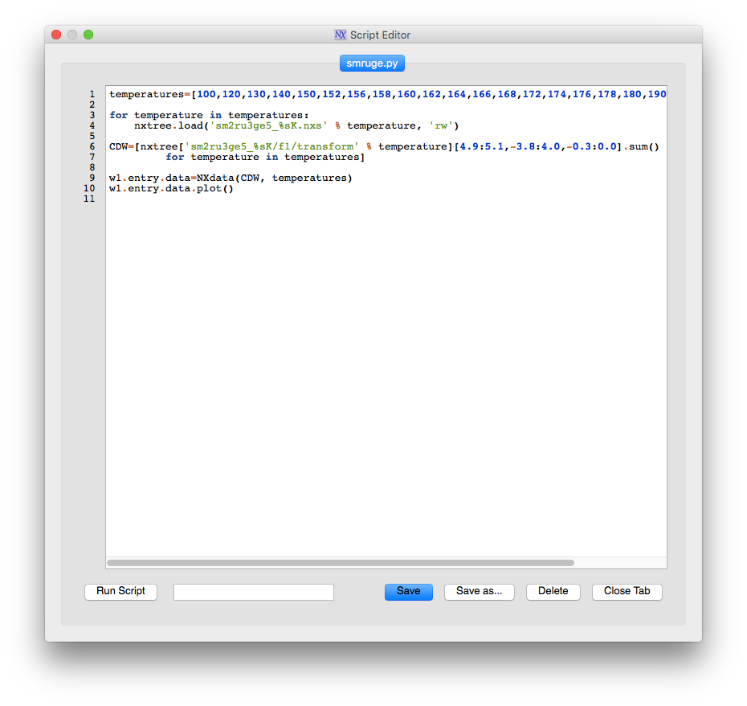
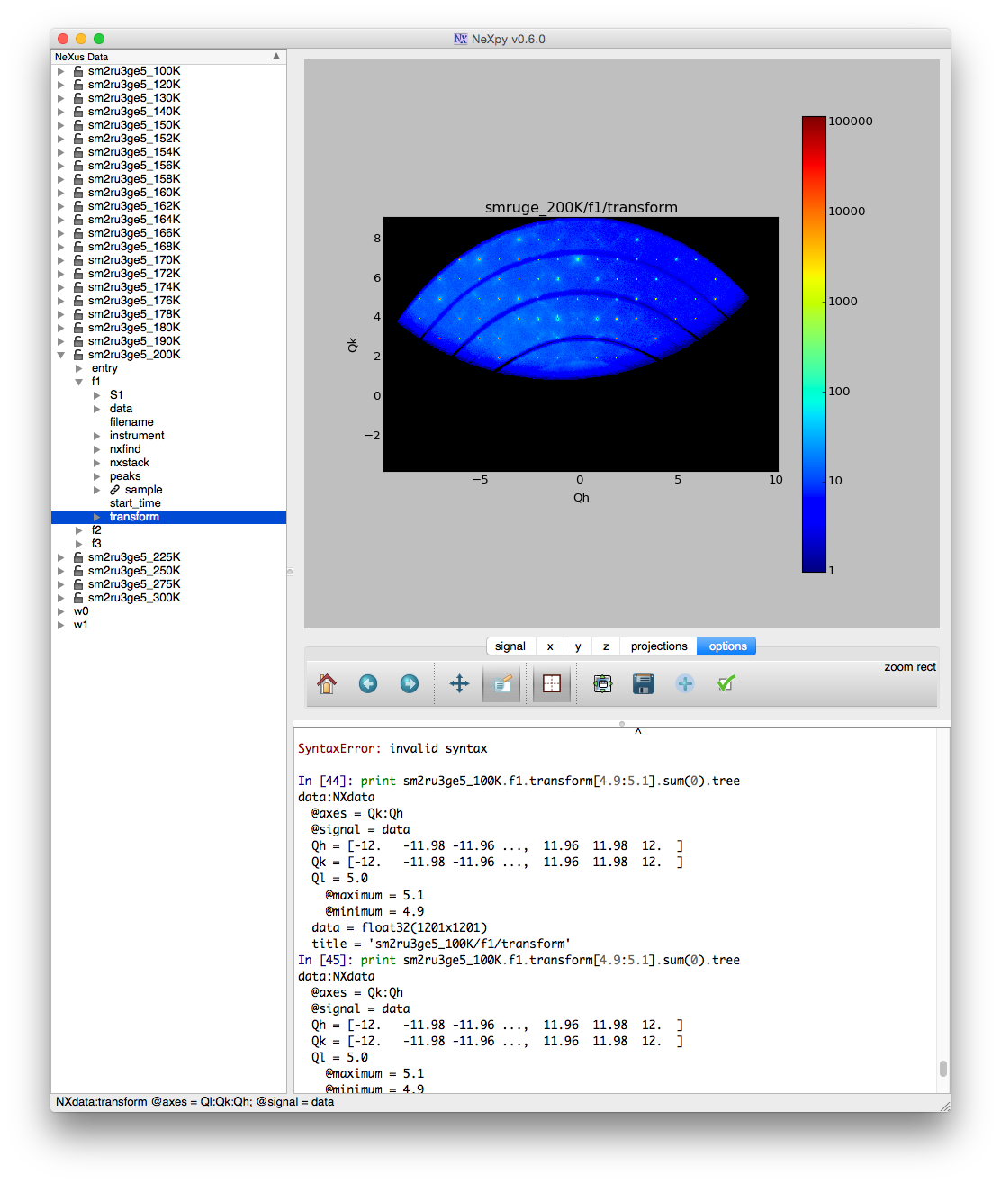
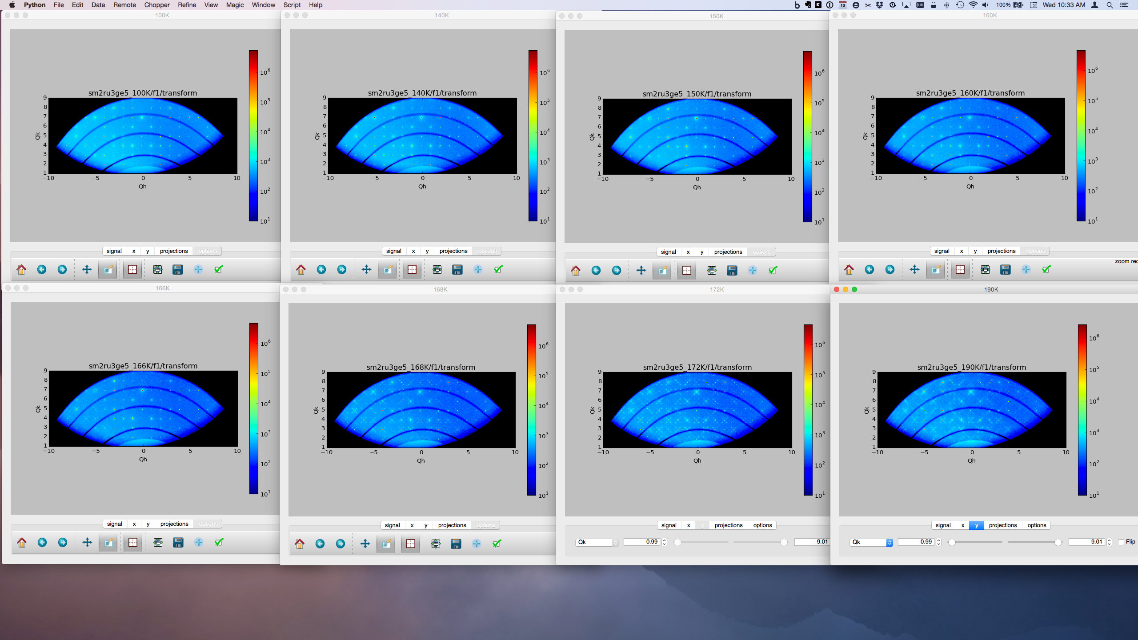
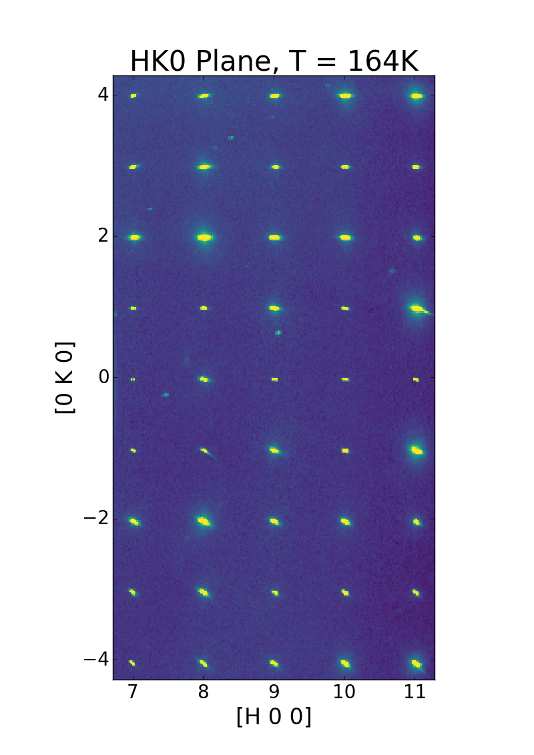
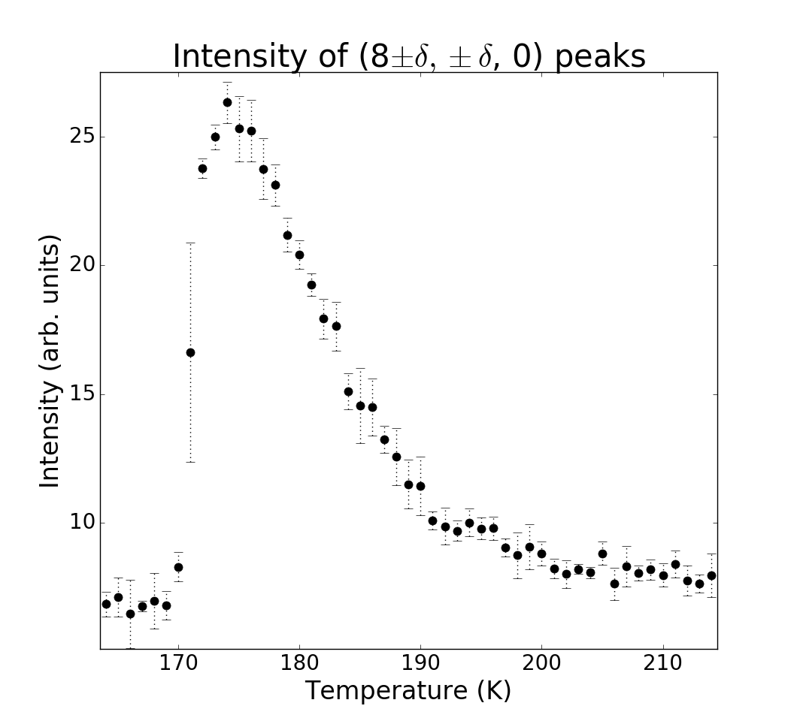
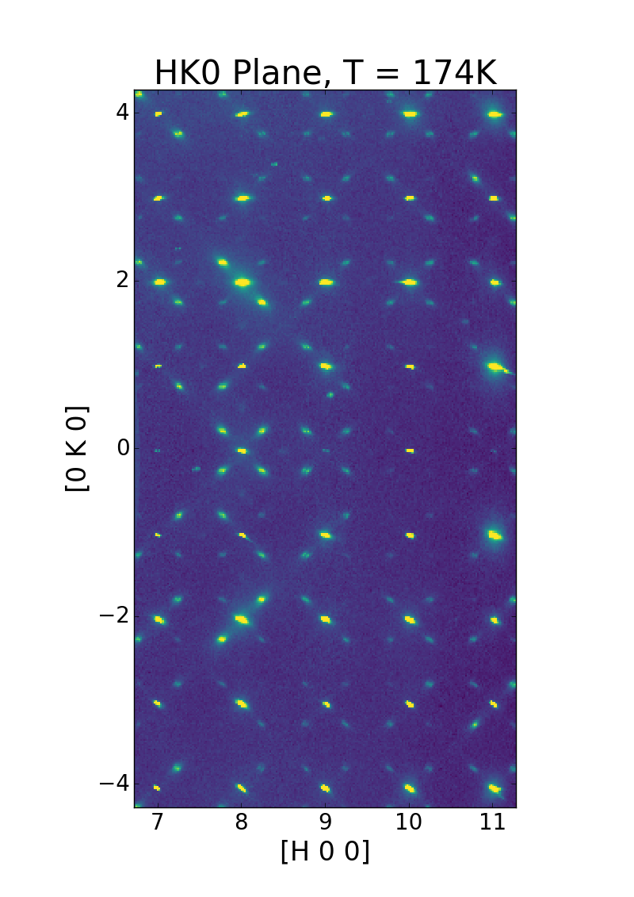
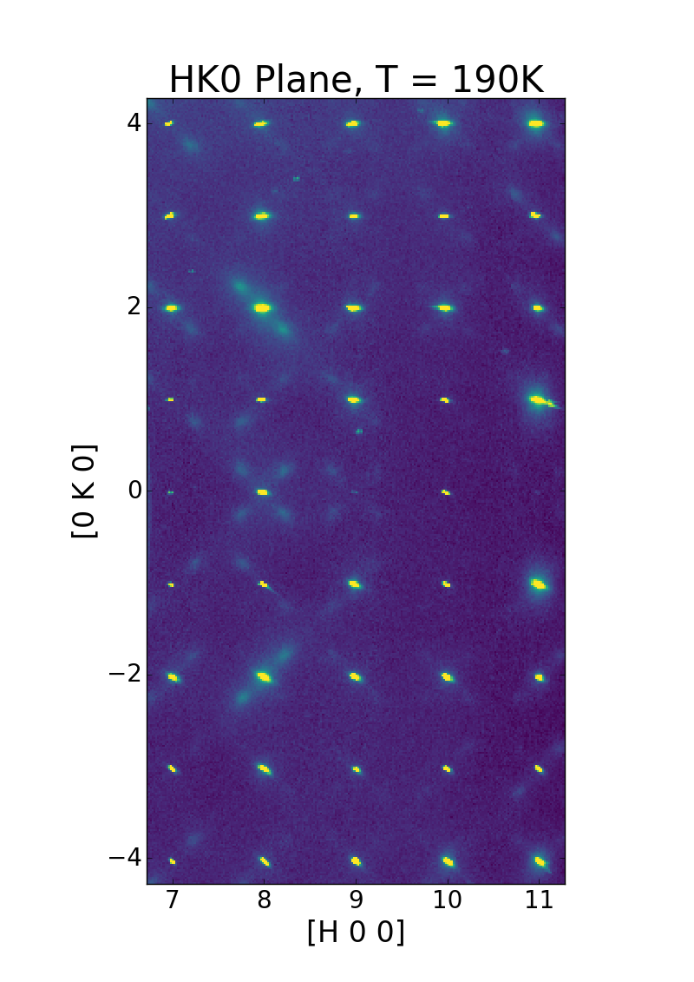
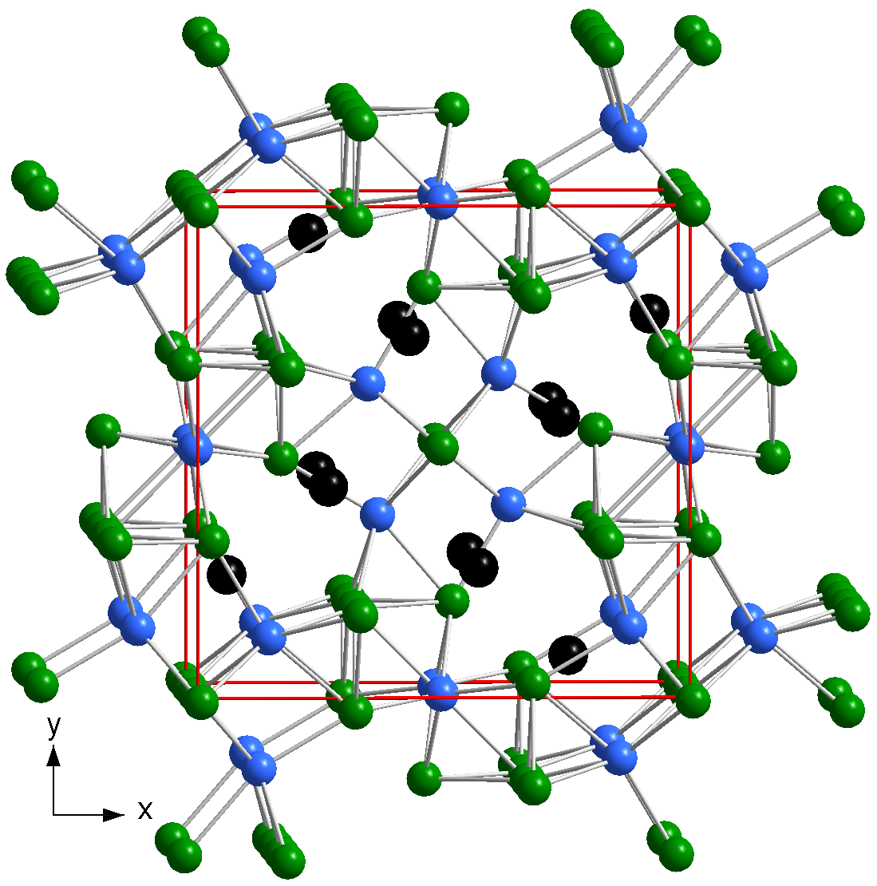
Charge Density Wave formation in Sm2Ru3Ge5
Daniel E. Bugaris, et al (Journal of American Chemical Society, accepted)
ExFaC Hack-a-thon on Cloud Data Servers - Feb. 28 to Mar. 3
Workshop on Midscale Instrumentation for Quantum Materials - December 5-6, 2016

Slide 9
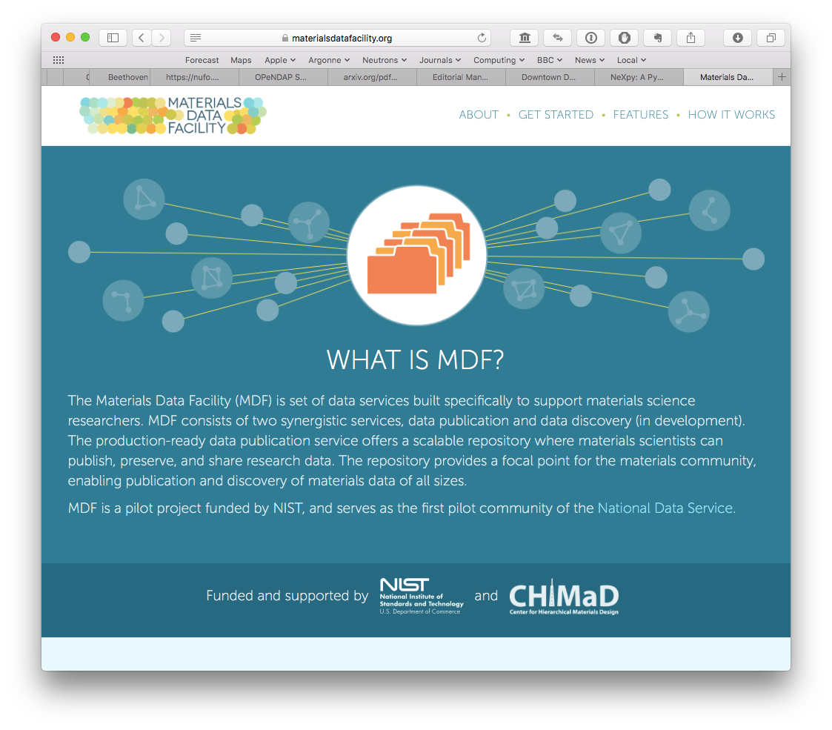
Materials Data Facility
http://materialsdatafacility.org
ExFaC Hack-a-thon on Cloud Data Servers - Feb. 28 to Mar. 3

Slide 10
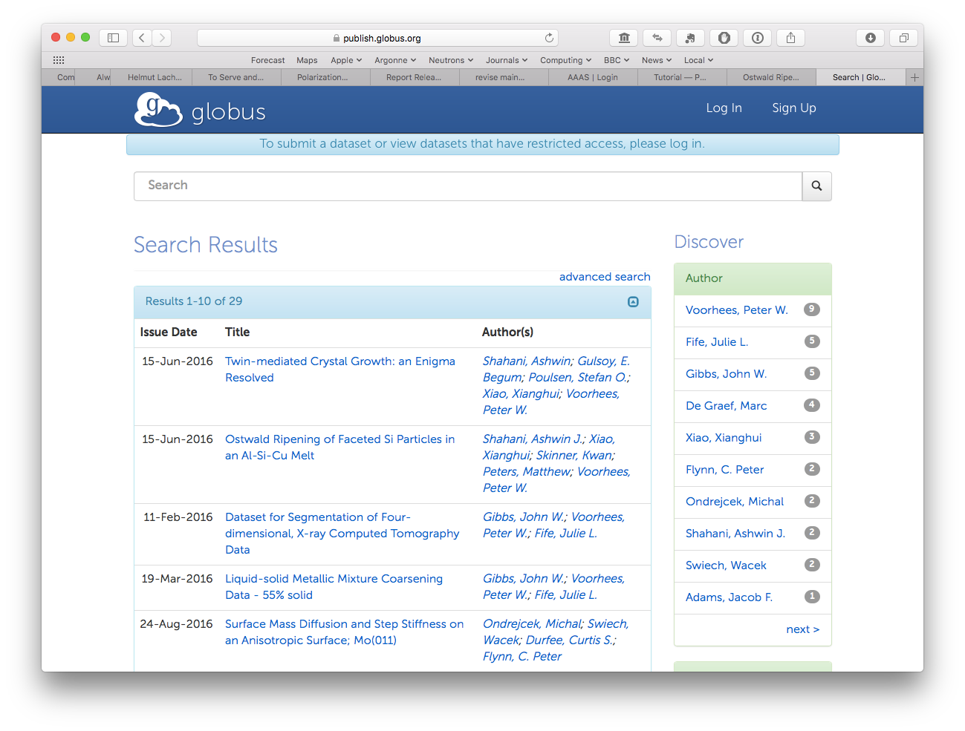
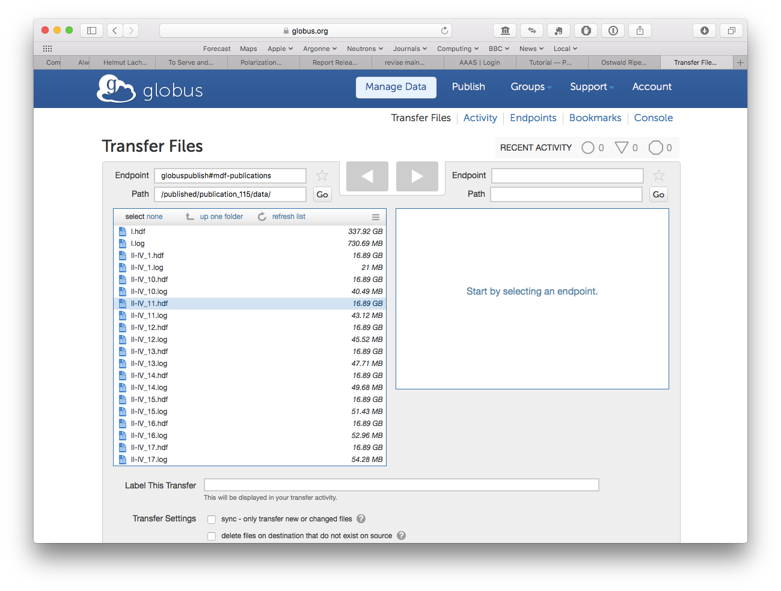
MDF Search
ExFaC Hack-a-thon on Cloud Data Servers - Feb. 28 to Mar. 3

Slide 11
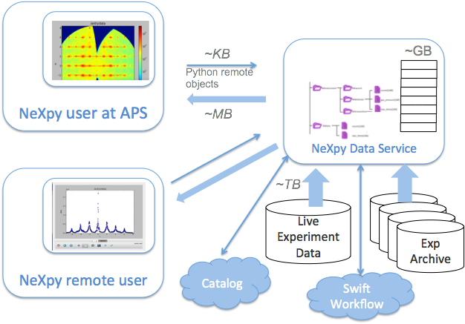
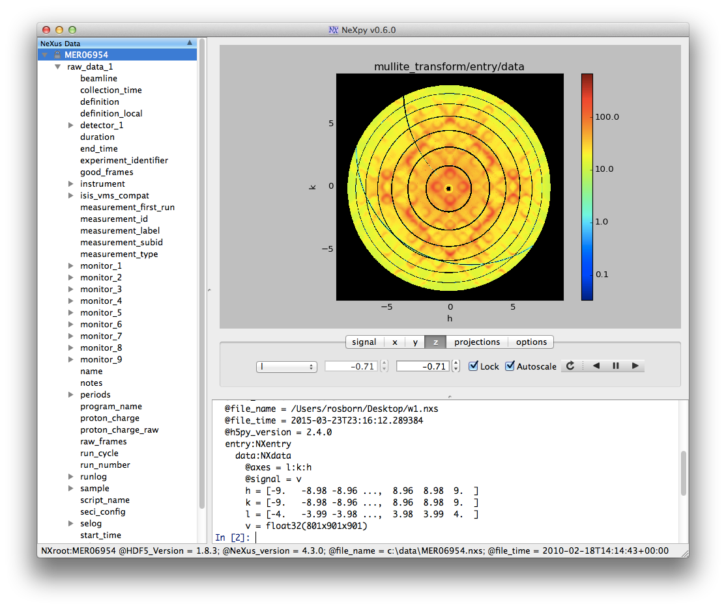
Remote Data Access
ExFaC Hack-a-thon on Cloud Data Servers - Feb. 28 to Mar. 3

Slide 12
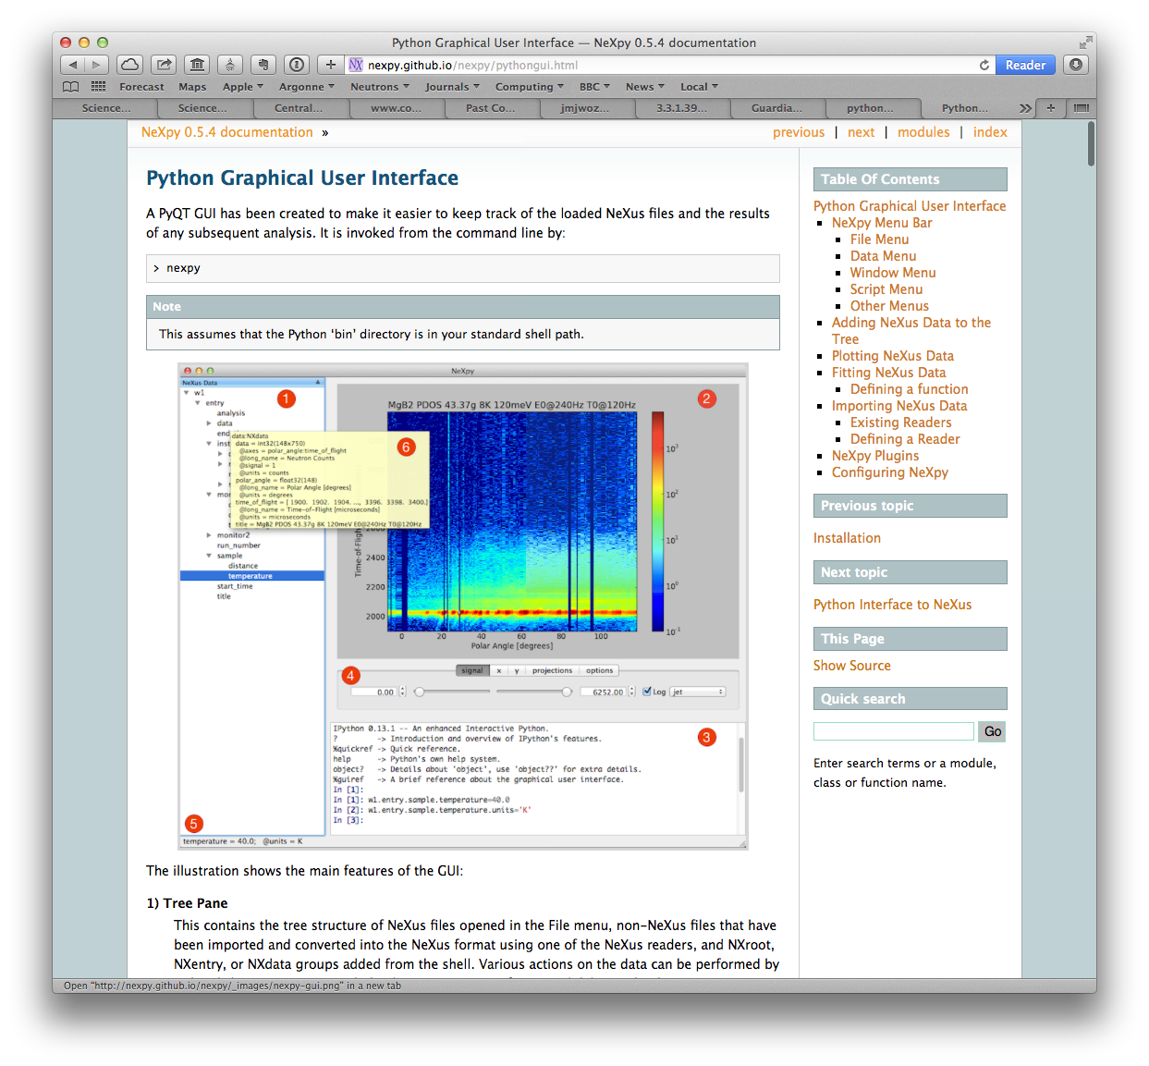




NeXpy - a Python toolbox for big data
A toolbox for manipulating and visualizing arbitrary NeXus/HDF5 data of any size
Python API lazily loads HDF5 files into memory
Large arrays can be manipulated as slabs
A scripting engine for GUI applications
A portal to online data
subclasses h5py.File as a remote file object
http://nexpy.github.io/nexpy/ $ pip install nexpy
$ conda install -c nexpy nexpy
=
+
ExFaC Hack-a-thon on Cloud Data Servers - Feb. 28 to Mar. 3

Slide 13
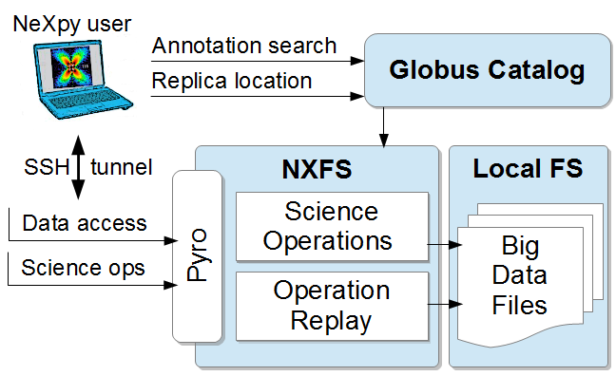
The NeXus File Service (NXFS)
Tested at APS, SNS, and CHESS
Wozniak et al. Big data remote access interfaces for light source science. Proc. Big Data Computing, 2015.
ExFaC Hack-a-thon on Cloud Data Servers - Feb. 28 to Mar. 3

Slide 14
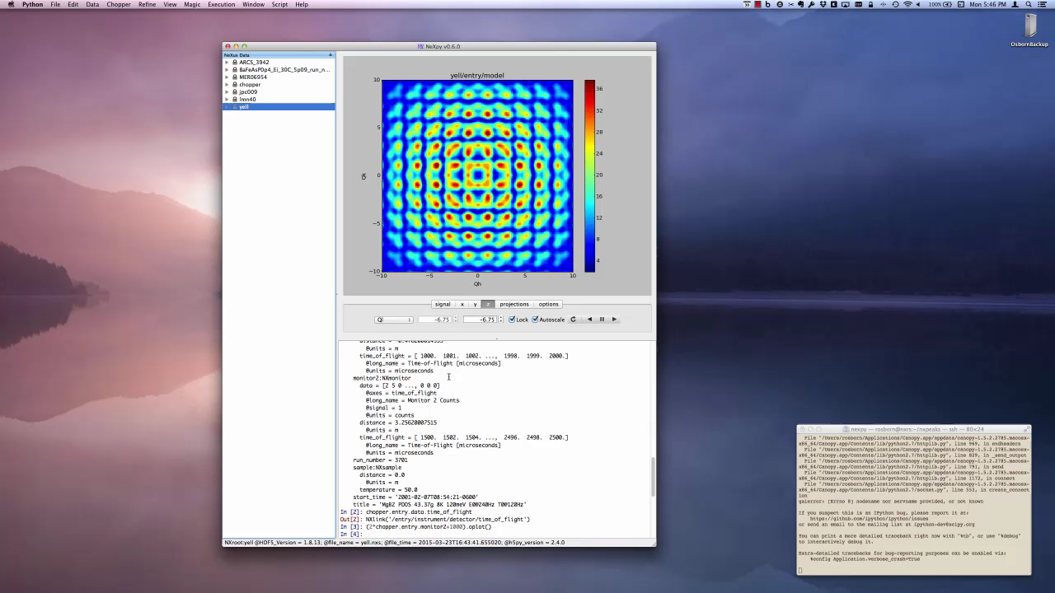
ExFaC Hack-a-thon on Cloud Data Servers - Feb. 28 to Mar. 3

Slide 15
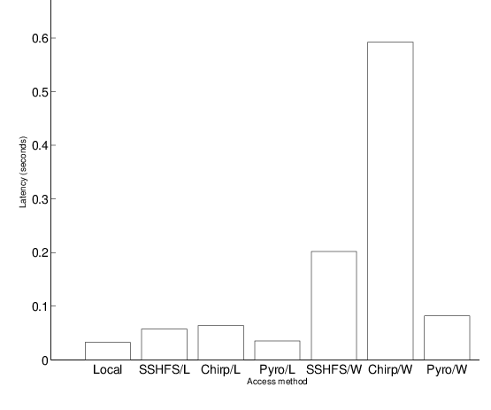
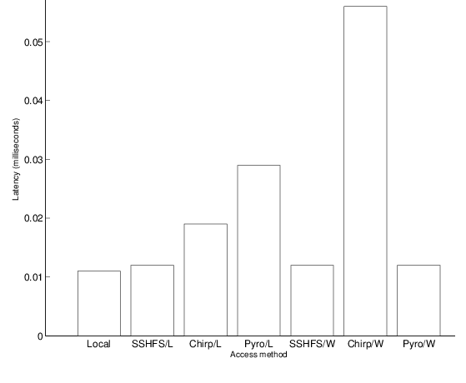
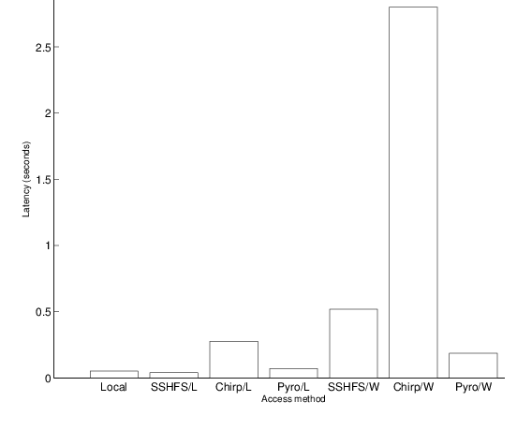
NXFS Performance
Faster than application-agnostic remote filesystem technologies
Compared Pyro to Chirp and SSHFS from inside ANL (L) and AWS EC2 (W)
Plus ability to invoke remote methods!
File open (10⁻¹s)
Metadata read (10⁻²s)
Pixel read (1s)
Operation and Time Scale
ExFaC Hack-a-thon on Cloud Data Servers - Feb. 28 to Mar. 3

Slide 16
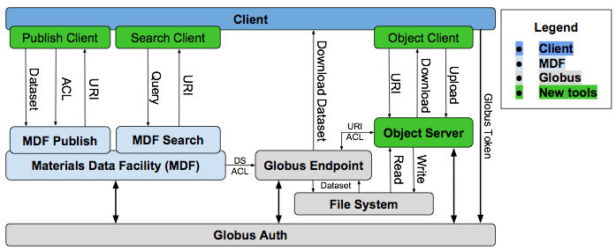
Conceptual Design of a Cloud Server
ExFaC Hack-a-thon on Cloud Data Servers - Feb. 28 to Mar. 3

Slide 17
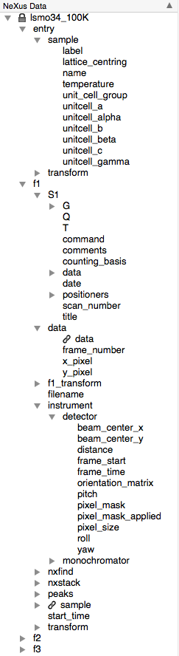
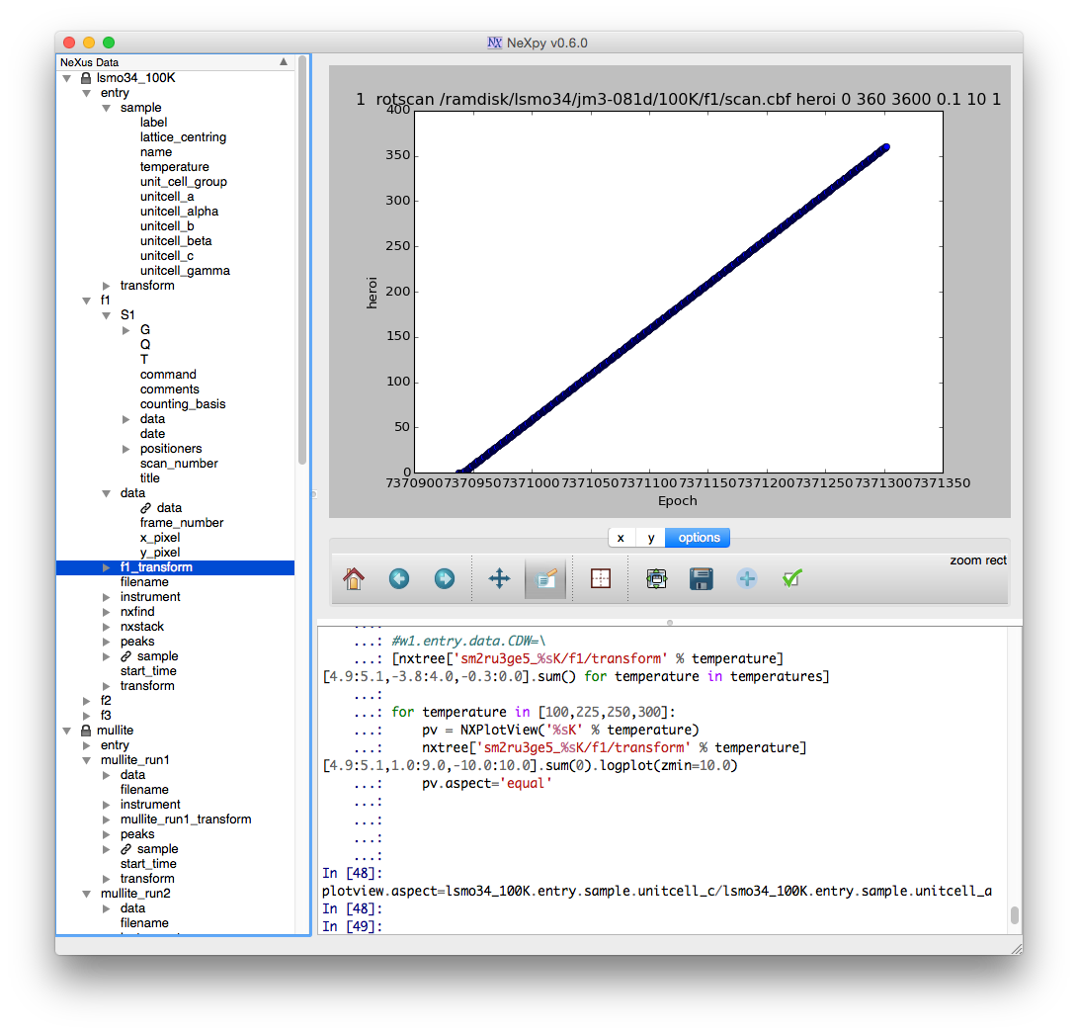
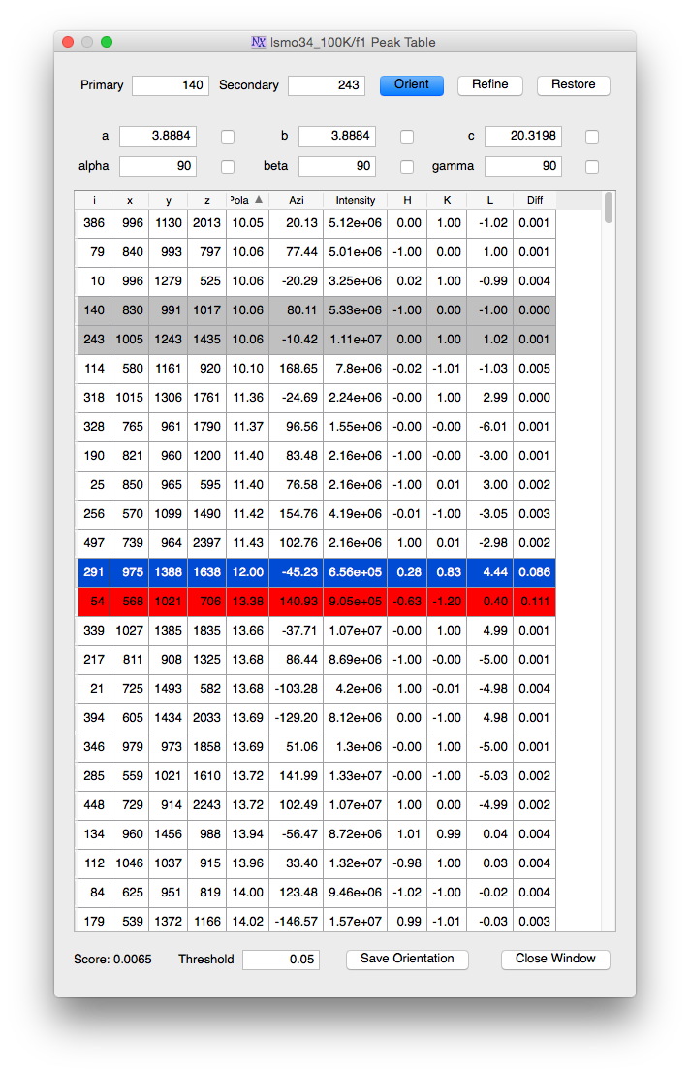
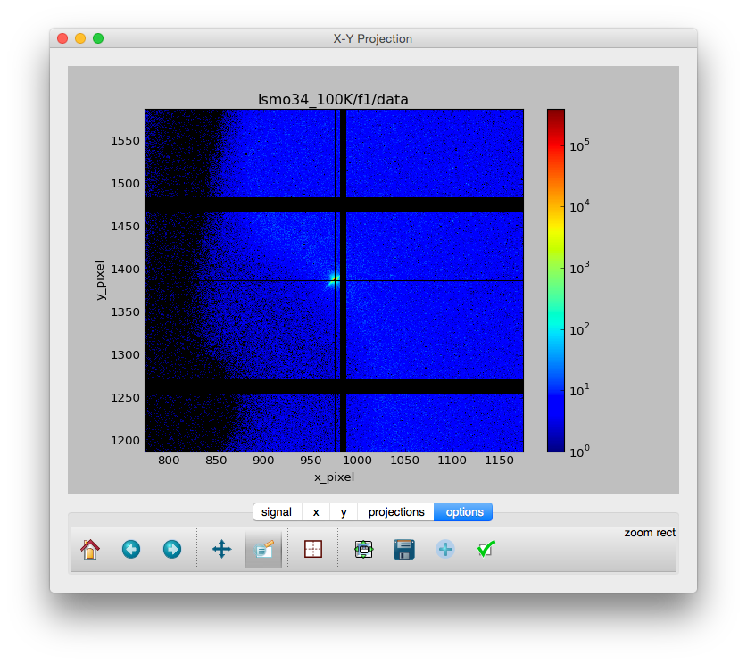
NeXus Wrapper Files
The data from the whole experiment can be encapsulated in a few “wrapper” files.
Large arrays are stored externally to ensure data integrity.
All other metadata is available with a single NeXus file load.
These files can include:
Raw data arrays from multiple detector configurations
Transformed data
Sample and instrument calibration parameters
Derived data, e.g., peak coordinates
Provenance information
Imported SPEC files
Simulation results
ExFaC Hack-a-thon on Cloud Data Servers - Feb. 28 to Mar. 3

Slide 18

Cloud Data Servers
It is no longer sufficient to provide a repository for data sets that are too large for users to download.
Instead, we need to establish data servers that can return data slabs and/or associated metadata.
In April, an RDA-sponsored workshop at the Alba Synchrotron will explore the following:
Data Discovery
How do we integrate existing resources to enable users to locate data?
e.g., Materials Data Facility, ICAT
Authentication
How do we provide unified authentication to grant users access to the remote data?
Server Queries
What queries will allow remote data inspection and selective downloads of data and metadata?
Transfer Protocols
How do we handle network requests and how do we serialize the data that is returned?
http://materialsdatafacility.org
ExFaC Hack-a-thon on Cloud Data Servers - Feb. 28 to Mar. 3

